Slide 1
PageRank Convergence
Komal Krishna Mogilipalepu

Slide 2

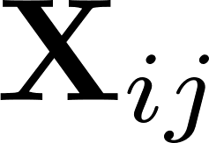


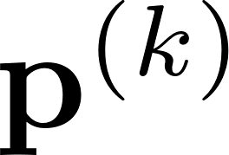
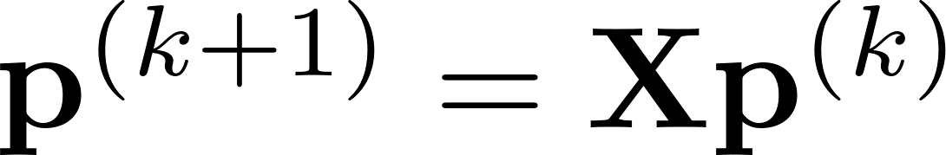
PageRank Formulation
Web is considered as a directed graph with nodes as the pages and edges as the links.
Connections between the nodes are modelled as a probability transition matrix
- Transition probability from node to
- distribution vector on the nodes which is same as the rank of the page
Limitations:
Dead ends
Spider traps
- no outgoing links from a node
- periodic graph. Starting from a node we can visit the same node in a fixed time interval.
Solution:
- teleportation - makes the Markov chain aperiodic and irreducible

Slide 3
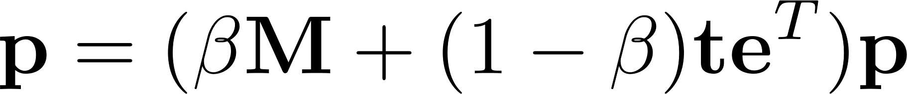

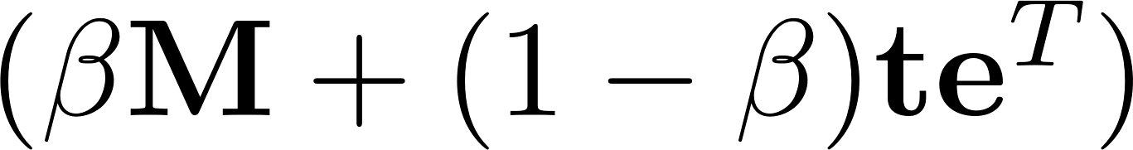
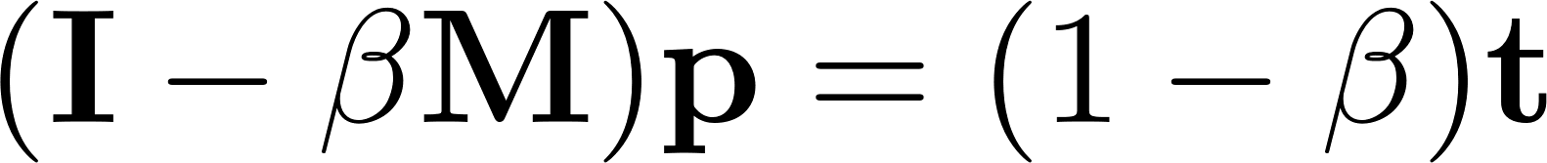

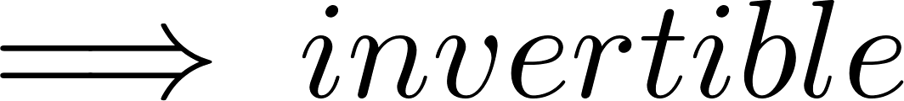
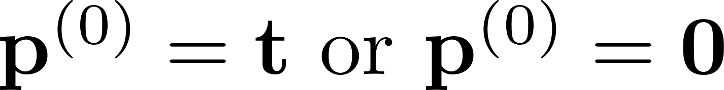
Stationary Distribution
A stochastic, aperiodic, and irreducible Markov chain has a stationary distribution.
-here, stationary distribution is an eigen vector corresponding to an eigen value 1 of the matrix
- strictly diagonally dominant
Iterative approach:
where
Error:

Slide 4
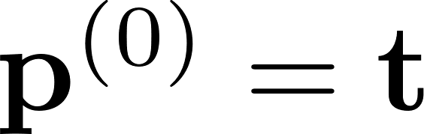
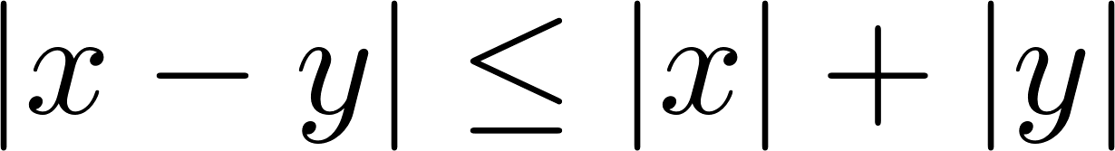
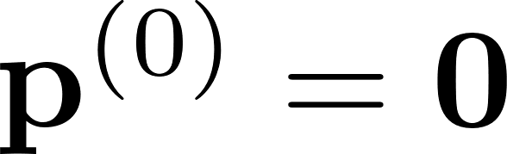
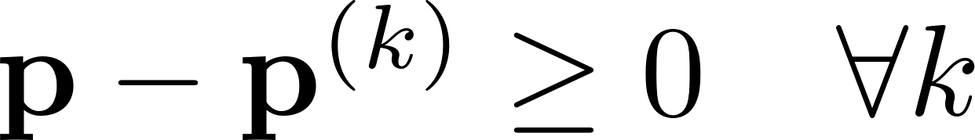
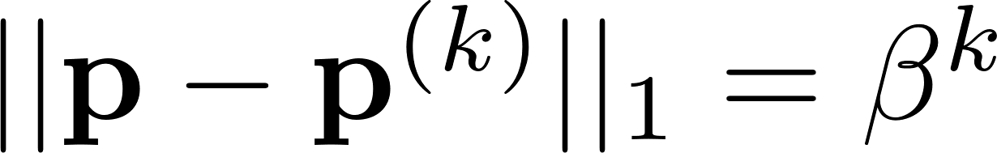
Convergence
If then
Proof: uses the following ideas
product of stochastic matrices are stochastic
triangle inequality
for any real value:
If then
and
Remark: It shows that zero initialization giving less error compared to random initialization, however practical experience suggests that random initialization results in faster convergence.
- it could be confirmed by computing the error by bounding it by residual.

Slide 5




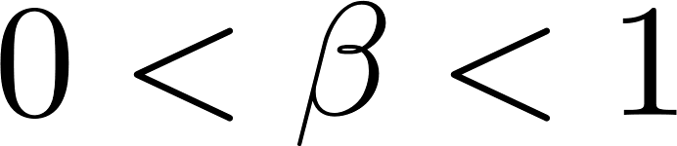
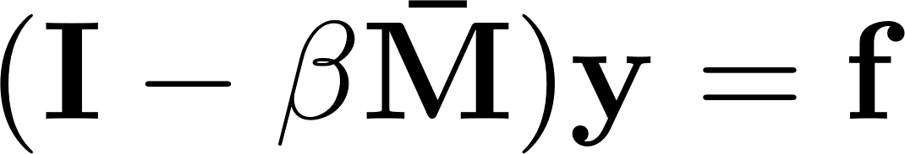

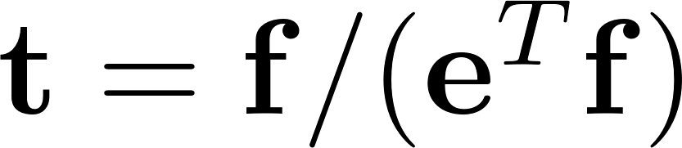
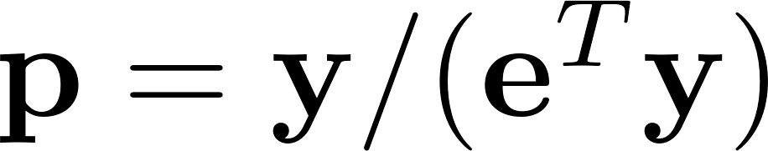


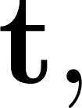
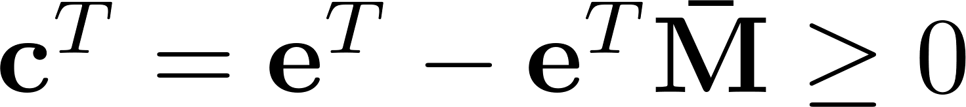
pseudo-PageRank
Let be a column-substochastic matrix with and element-wise.
Let be a nonnegative vector, and let be a teleportation parameter.
Then the pseudo-PageRank problem is to find the solution of the linear system
where pseudo-PageRank vector.
Let then is the solution of a PageRank system with
and
where
is a correction vector.
Similar to PageRank, we can show the convergence guarantees for pseudo-PageRank.

Slide 6
References:
https://www.cs.purdue.edu/homes/dgleich/publications/Gleich%202015%20-%20prbeyond.pdf
https://www.youtube.com/watch?v=UZePPh340sU&t=329s

